Slide 1
GESTURE CONTROLLED ROBOT
SWITCHING THEORY LAB MINI PROJECT
Name : Asutosh Swain
Roll No: 1701CS12

Slide 2
OBJECTIVE
To make a gesture controlled robot with Arduino and Ultrasonic sensor.

Slide 3
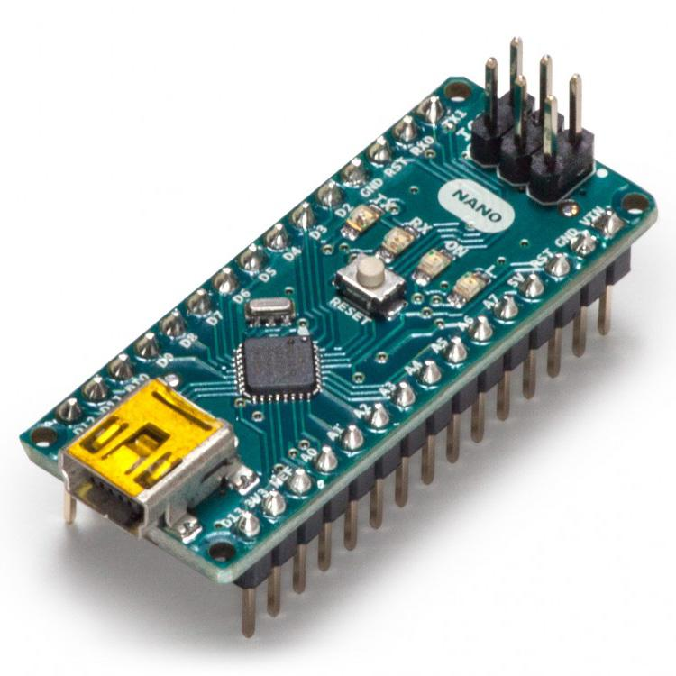
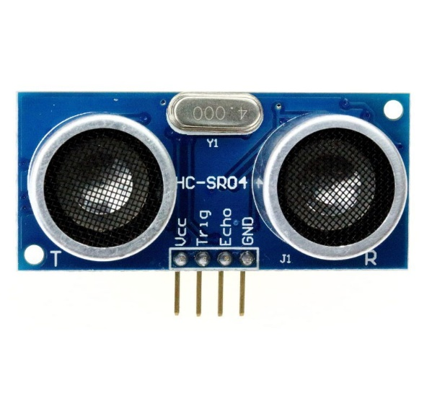
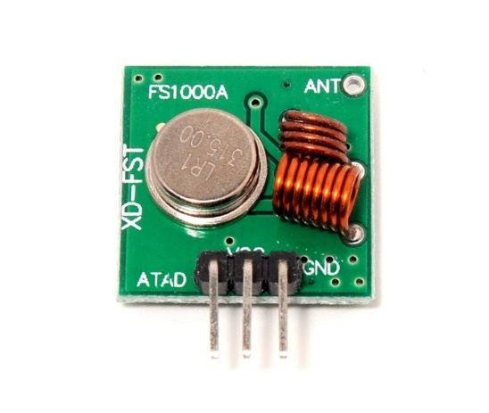
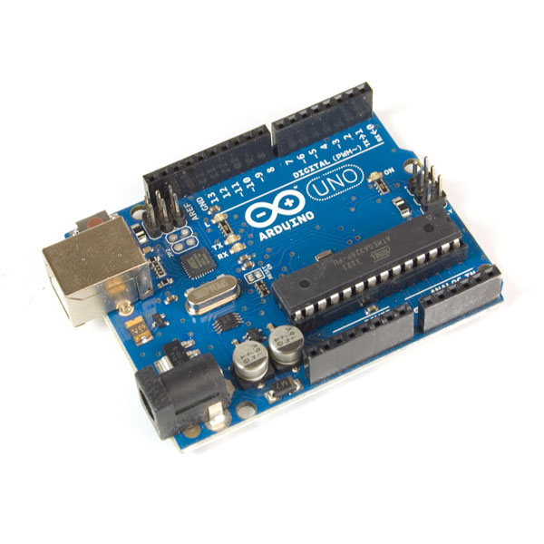
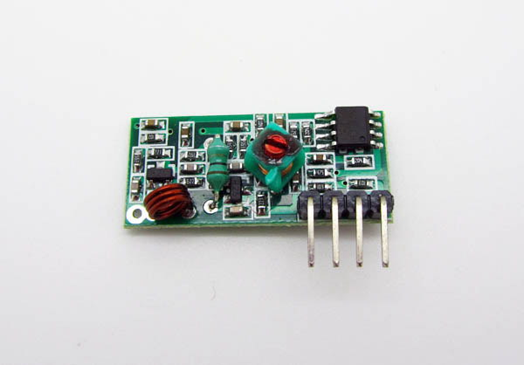
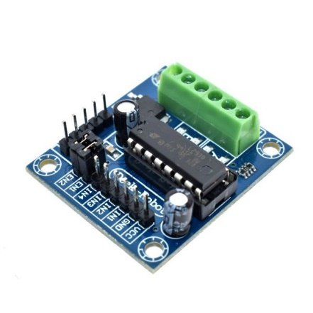
Hardware used:
Arduino Nano
RF Transmitter
Ultrasonic Sensor
RF Receiver
Arduino Uno
Motor driver

Slide 4
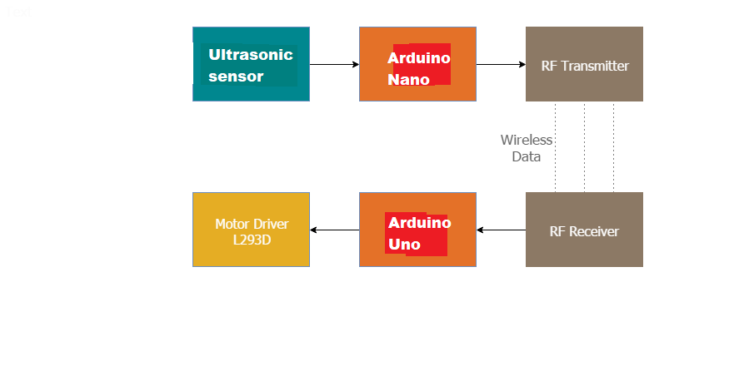
Flow Chart for working of the model:

Slide 5
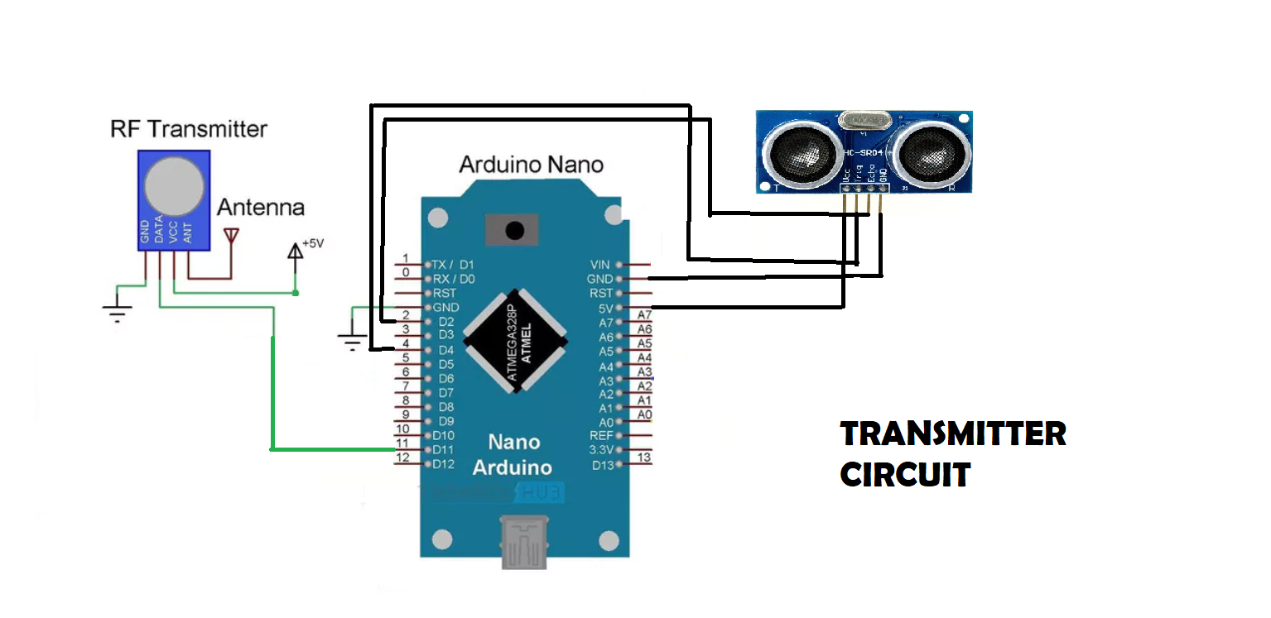
Working of Transmitter circuit:
The Ultrasonic sensor measures the distance and Arduino processes it sends it
through the Rf transmitter module.

Slide 6
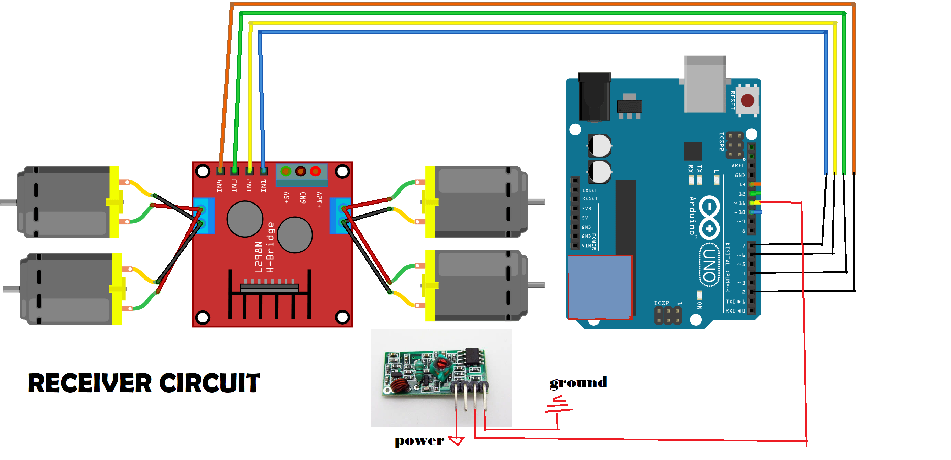
Working of Receiver circuit:
The RF receiver module receives the distance as a radio packet and the Arduino Uno
Processes it gets the distance and sends signal to motor driver for functioning.

Slide 7
THANK YOU

